Slide 1



AICTE Student ID: STU670691bf4b9a31728483775
Garbage Classification using
AI & ML
SOURCE CODE REPOSITORY:
https://github.com/Gurubrahma1982/GARBAGE-CLASSIFICATION-INTERNSHIP-EDUNET.git

Slide 2

Learning Objectives
Gained a clear understanding of why proper waste segregation is important for the environment and public health.
Learned how machine learning can be used to automatically classify garbage into categories like organic, recyclable, and hazardous.
Got hands-on experience in working with image datasets from collecting and cleaning data to training the model.
Explored tools like Python, TensorFlow/Keras, and Jupyter Notebook for building the classification model.
Understood how to evaluate model performance and improve accuracy using various techniques
GOAL
Source :
www.freepik.com/

Slide 3
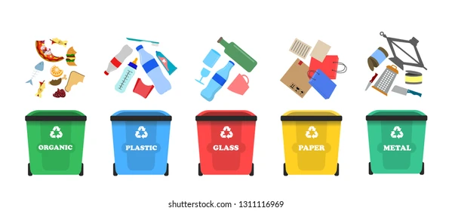
Tools and Technology used
Python – Used as the main programming language for building and training the model.
Jupyter Notebook / VS Code – For writing, testing, and debugging the code.
TensorFlow / Keras – Used for building and training the convolutional neural network (CNN) model.
OpenCV / PIL – For handling and preprocessing image data.
NumPy & Pandas – For data manipulation and numerical operations.
Matplotlib / Seaborn – To visualize training results and accuracy graphs.
Gradio (if used) – For creating a simple web interface to test the model predictions.

Slide 4
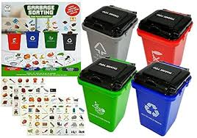
Methodology
Dataset CollectionCollected a garbage image dataset from Kaggle, containing different types of waste like plastic, metal, organic, etc.
Data PreprocessingResized and cleaned the images, applied normalization, and split the dataset into training and testing sets.
Model BuildingUsed a Convolutional Neural Network (CNN) to train the model for image classification.
Training the ModelTrained the model using multiple epochs while monitoring accuracy and loss to improve performance.
EvaluationTested the model on unseen data and analyzed the results using metrics like accuracy and confusion matrix.
Deployment (Optional)Integrated the model with a simple interface using Gradio to test real-time predictions.

Slide 5
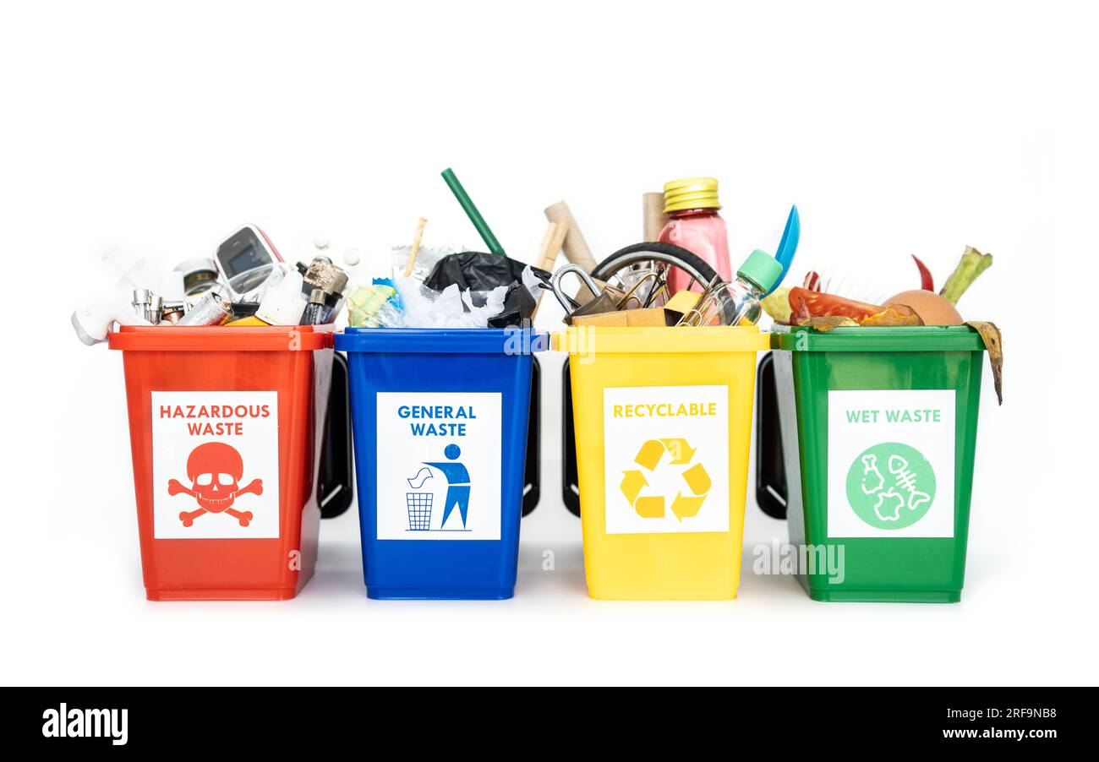
Problem Statement:
Improper waste segregation is a major issue in many cities.Most of the garbage is dumped without separating organic, recyclable, and hazardous materials, which leads to:Increased pollutionLow recycling efficiencyHealth risks for sanitation workersOverflowing landfillsThere is a need for an automated system that can classify garbage correctly using machine learning to support better waste management.

Slide 6
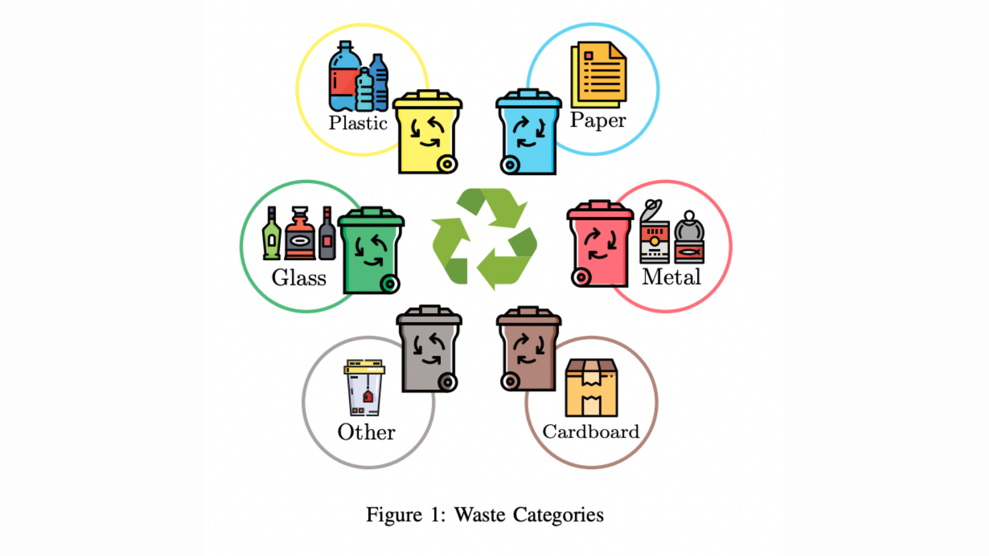
Solution:
To solve the problem of improper waste segregation, we developed a machine learning-based image classification model that can:Automatically identify and classify garbage images into categories like organic, recyclable, metal, plastic, etc.Help reduce manual work and errors in waste sorting.Support smart waste management systems in cities and organizations.Improve recycling efficiency and reduce environmental pollution.This solution uses a Convolutional Neural Network (CNN) trained on a labeled dataset of garbage images.

Slide 7
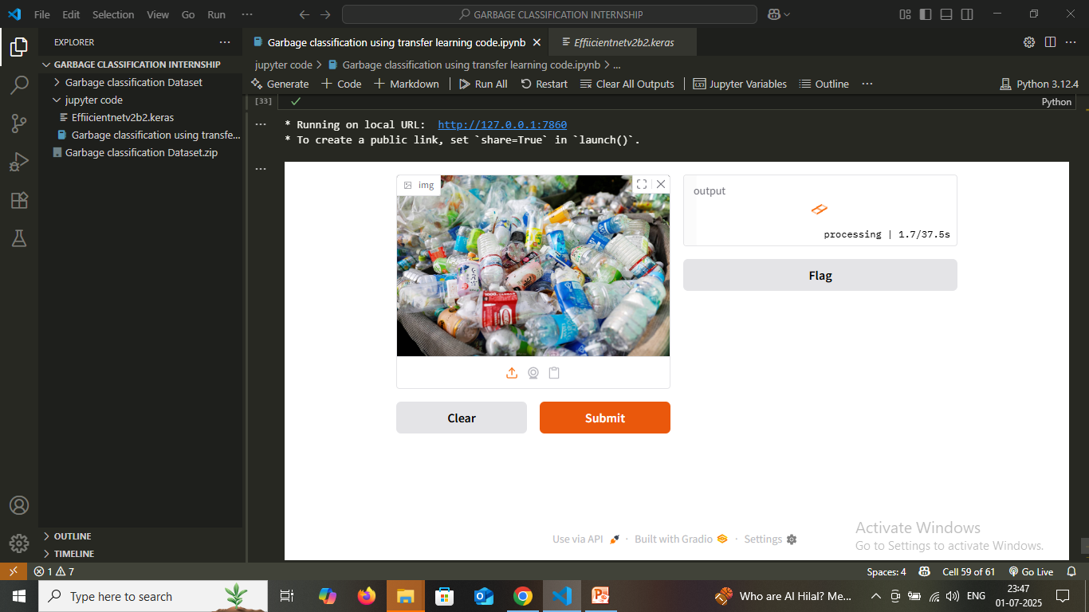
Screenshot of Output:

Slide 8
Conclusion:
Through this project, I successfully built a model that can classify different types of garbage using machine learning.It helps in automating the waste segregation process, which is essential for cleaner and greener cities.The project gave hands-on experience with data preprocessing, model building, and evaluation.It also showed how AI can be used for solving real-world environmental problems.This is just a starting point — the model can be further improved and used in smart dustbins or integrated into municipal systems.

